Slide 1
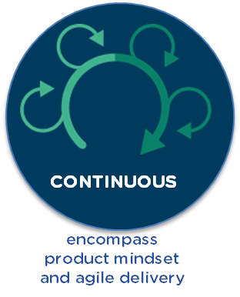
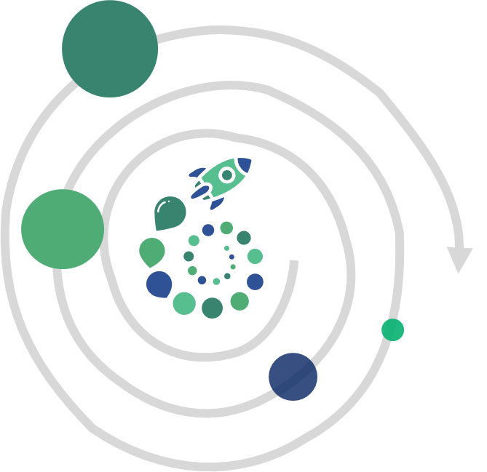
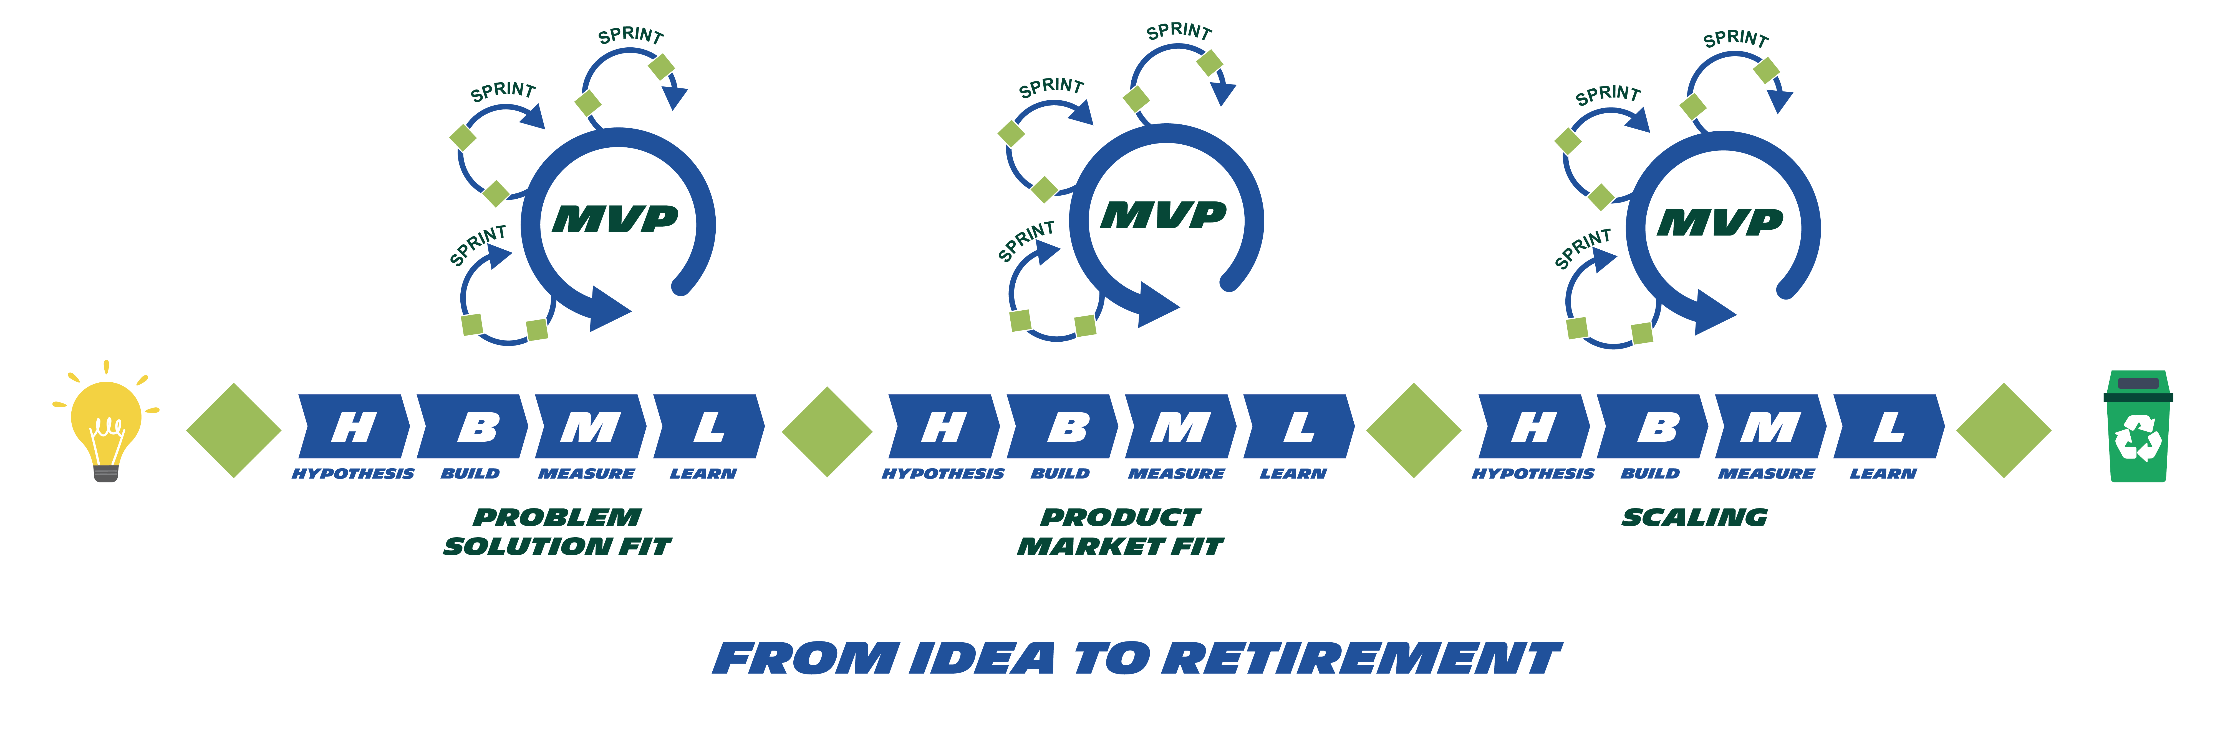


WEEKLY ARCHITECTURE
MEETING
(CONTINUOUS DECISION)
ARCHITECTURE WORKSHOP
(ALIGNEMENT WITHIN SCOPING 360°)
Notes:
From idea to retirement
LEAN AGILE = Succession of MVP
Architecture : Key at the scoping phase
Architecture : Continuous and closes to the sprint functional and technical issues
IDEA TO RETIREMENT
MVP
ARCHITECTURE RITUALS

